Slide 1
2021 Final Budget & Levy Adoption
December 1st 2020

Slide 2
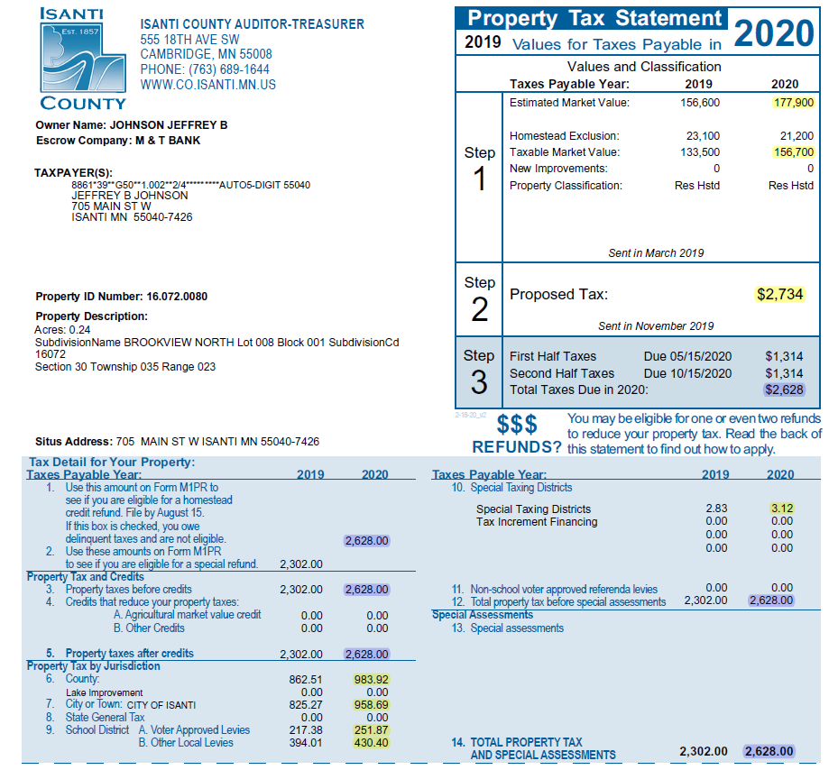
Value Determined by County Assessor, 90-105% of Fair Market Value by Statute
TMV=EMV Less Exclusions
Total Amount Originally Proposed
by Taxing Jurisdictions (September)
Total Amount After Final Adoption
By Taxing Jurisdictions (December)
10. East Central Regional
Development Commission
6. County Tax Amount
7. City Tax Amount
9.A/B. School District Tax Amount

Slide 3
Property Tax Calculation
Why Tax Rate Is More Important Than Levy Amount
Levy Will Always Go Up Over Time
Tax Rate Provides Better Comparison Between Cities And Years
Tax Rate = Levy / Tax Capacity (Adjusted Market Value)
Property Value X Tax Rate = Property Taxes
Property owners can appeal the assessed value of their property at the annual Local (April) or County (June) Board of Equalization Meeting. Appeals affect the coming tax year, not current tax year.

Slide 4
Components of Municipal Budget
Category | Revenue | Expense | Competency
Operating Rev/Exp | GF Levy / Rates | 3-5 yr Avg., 6m Actual | All - Easy But Not Assured
Intergovernmental Rev/Exp | LGA / Grants | Regulations / Legislation | All - Legal Requirement
Capital Projects | Levy / Rates | 10-20 year Horizon | Most - $ to Engineer
Capital Maint./Replacement | Levy / Rates | 20 year Horizon | Few - Difficult **
** Largest Available Marginal Competitive Advantage

Slide 5
Budget Options to Consider
Delaying Street Improvement Projects
  All current projects were originally identified in 2010
Delay / Eliminate Capital Maint/Replacement Items
  All items have been identified as needed
Reduce Operating Expenditures
  Contracts and other legal obligations limit scope of possible cuts
Alter Fund Balance Contribution
  Current Budget intentionally adds $76,018 to General Fund, Fund Balance

Slide 6
Budget Summary

Slide 7
Budget Summary

Slide 8
Fiscal Management
Manage Components of Municipal Budget
Consider Associated Timelines
Small & Steady Increases/Decreases in Levy/Tax Rate Over Time

Slide 9
Fiscal Management
Small & Steady Increases/Decreases in Levy/Tax Rate Over Time
Manage Components of Municipal Budget
  Operating Rev/Exp
    Staffing, PRC Programming, Road Maint., Snow Removal, Police Presence/Patrols, Fire Protection
    Capital Projects
      Identify and fund on consistent annual basis. Expenditures will vary annually but revenue collection should be consistent and predictable
      2028 is scheduled for 1.37 million in expenses. 2028 levy for street projects expected to be 352k.
      Avoid issuing bonds (debt) whenever possible. Borrowing 1 million costs roughly 250k in interest and issuance costs
      Capital Maintenance/Replacement
        Identify and fund on consistent annual basis. Expenditures will vary annually but revenue collection should be consistent and predictable
        2025 is scheduled for 3.97 million in expenses. 2025 levy for Capital Maint/Replacement is expected to be 494k
        20-year plan should include ALL maintenance and replacement items. From squad cars and plow trucks to tuck pointing brickwork
        Review annually and only replace when needed. If equipment performs beyond expected useful life, move scheduled expense to following year and reevaluate.

Slide 10
Considerations in Setting Levy
Capital Project Funding
  Next 10 years of street projects identified in 2010 to begin in 2012
  Capital Maintenance/Replacement Funding
    20-year cash flow analysis
    Fund Balance – General Fund
      85k annual repayment to Water/Sewer Funds for Hotel Project, 10 years
      26k annual repayment to Liquor Fund for 2018 Improvements, 10 years

Slide 11
Proposed Levy
LEVY | 2020 | 2021
GENERAL FUND LEVY (101) | $ 1,828,826 | $ 1,919,300
CAPITAL MAINT. LEVY (920) | $ 256,000 | $ 438,700
STREET CONST. LEVY (425) | $ 163,000 | $ 286,500
EDA LEVY (108) | $ 79,802 | $ 86,201
ABATEMENT LEVY (101) | $ 24,066 | $ 13,432
DEBT SERVICE LEVY | $ 369,312 | $ 281,630
929 - 2010B GO BOND | $ 85,000 | $ -
930 - 2011A GO BOND | $ 7,805 | $ 9,367
931 - 2014A TAX ABATEMENT | $ 225,501 | $ 222,036
932 - 2014B GO BOND | $ 51,006 | $ 50,227
TOTAL LEVY | $ 2,721,006 | $ 3,025,763

Slide 12
Levy History

Slide 13
Proposed Tax Rate
 | 2020 | 2021 | CHANGE FROM PRIOR
TAX RATE | 61.18% | 61.18% | 0.0%
AVG. TAX RATE - 2016-2020 | 74.77%
AVG. TAX RATE - 2006-2020 | 67.63%

Slide 14
Tax Rate History

Slide 15
Levy / Tax Rate History

Slide 16
Competitive Metric
 |  | TAX RATES
COUNTY | CITY | 2018 | 2019 | 2020
WRIGHT | OTSEGO | 36.556 | 36.060 | 35.099
ANOKA | RAMSEY | 41.727 | 40.353 | 39.592
ANOKA | LINO LAKES | 42.825 | 41.816 | 39.869
SHERBURNE | ZIMMERMAN | 45.656 | 44.578 | 41.239
ANOKA | EAST BETHEL | 44.510 | 43.204 | 41.467
SHERBURNE | ELK RIVER | 46.011 | 45.907 | 46.241
CHISAGO | NORTH BRANCH | 52.982 | 49.466 | 47.411
ANOKA | ST. FRANCIS | 53.996 | 53.175 | 50.542
ISANTI | ISANTI | 79.599 | 61.818 | 61.180
SHERBURNE | PRINCETON | 71.907 | 69.782 | 66.565
ISANTI | CAMBRIDGE | 81.252 | 76.653 | 75.052
ISANTI | BRAHAM | 84.841 | 84.391 | 76.354

Slide 17
Public Input / Discussion
The Minnesota Department of Revenue provides the following guidance regarding tonight’s meeting:
Discuss budget and proposed property tax
The proposed property tax levy for the taxes payable year 2021 and the proposed budget for the taxes payable year 2021, must be discussed at the public meeting.
Public comment and questions
The public must be given a reasonable amount of time to comment on the proposed property tax levy and budget and to ask questions. Robert’s Rules of Order may be used to govern the conduct of the meeting.

